Slide 1
AWS Data / ML
@LynnLangit

Slide 2
Outline
D1 - Data
D2 - ML
S3 / SnowCone
DynamoDB
Aurora
Redshift
Glue & Lake Formation (Athena?)
Data Pipeline?? (ML APIs??)
EMR & Spark
Deep Learning AMI
SageMaker

Slide 3
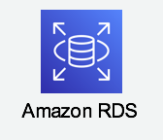
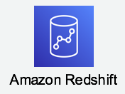
AWS SQL Choices
AWS Aurora - OLTP
AWS Redshift - OLAP
Transactions
App backends
Frequent Access
Fast Writes
Row-based storage
Analytics
Data feeds for BI and viz tools
Massive volumes
Fast Reads
Column-based storage

Slide 4
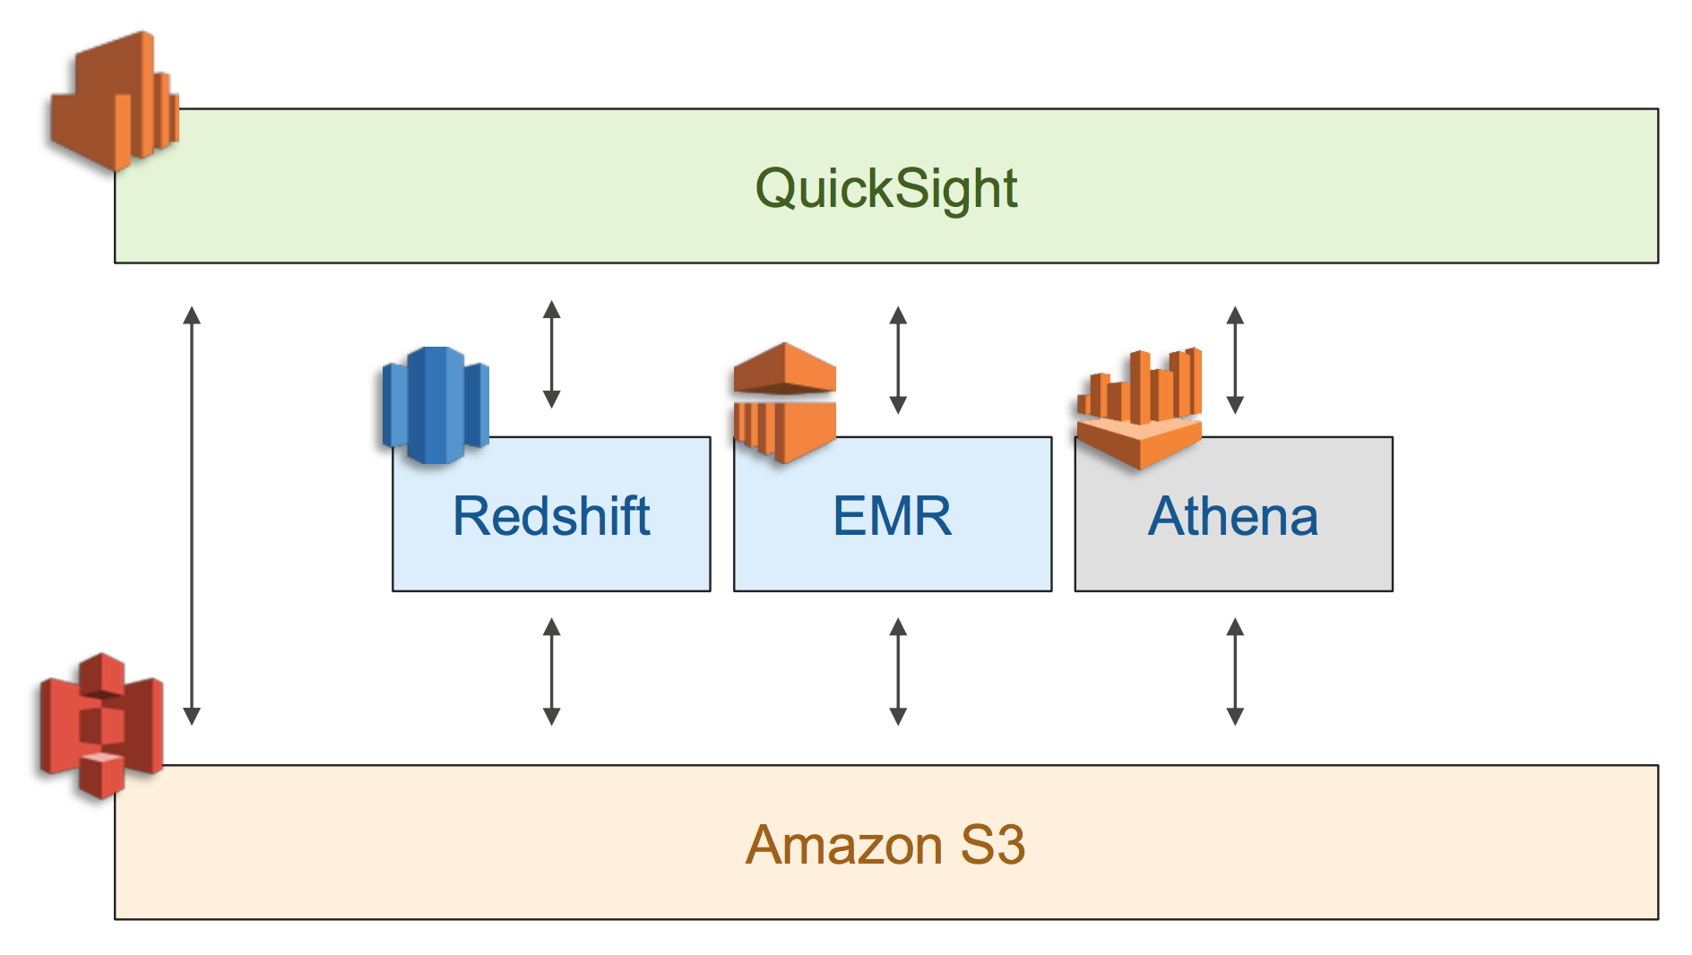

Slide 5
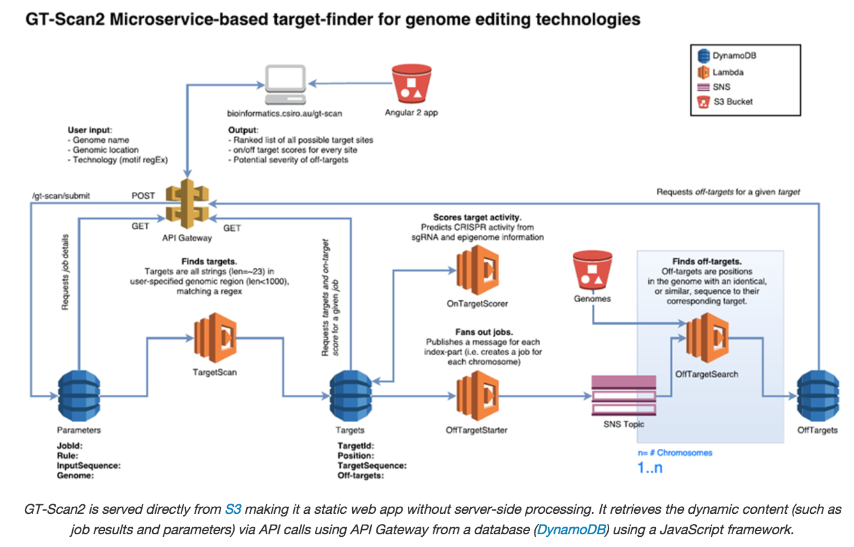

Slide 6
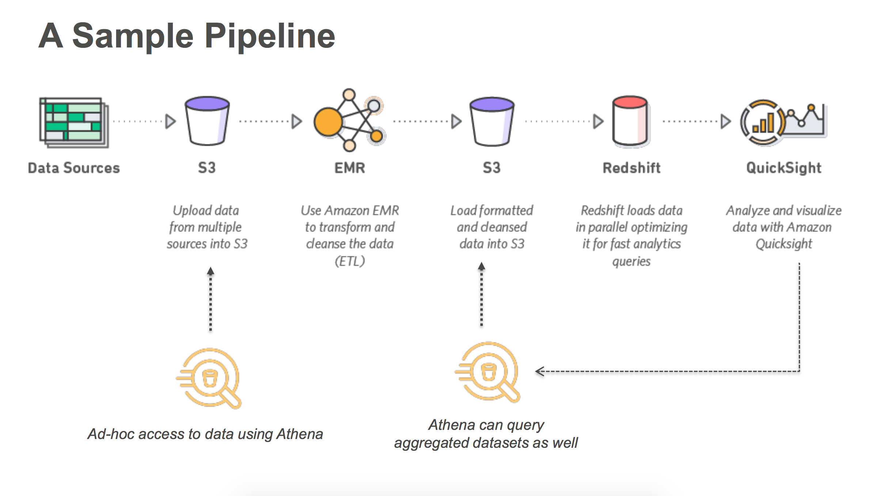

Slide 7
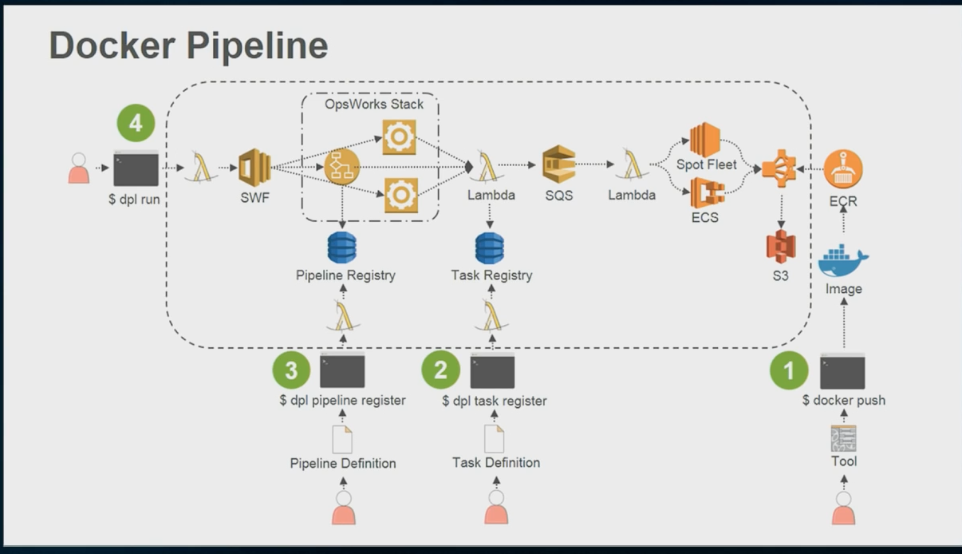

Slide 8
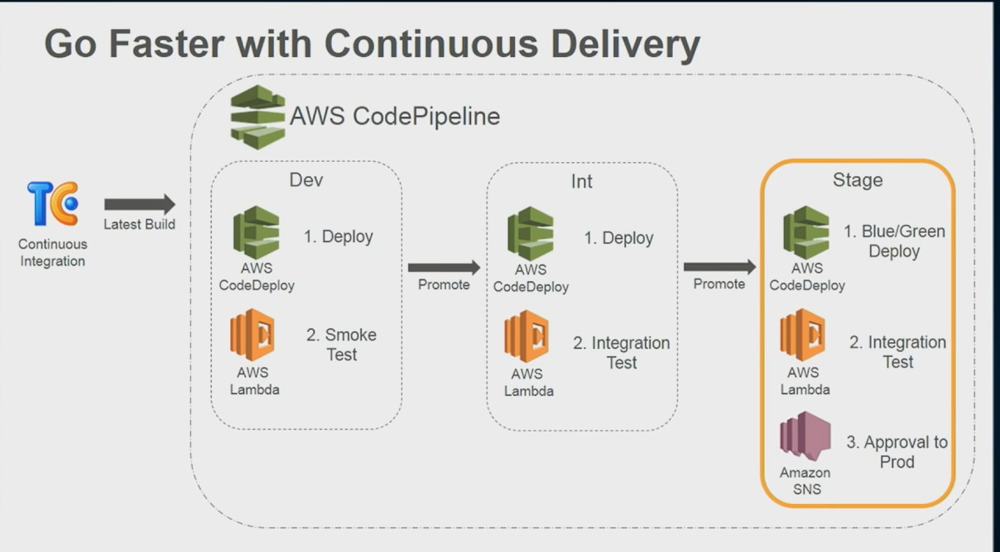

Slide 9
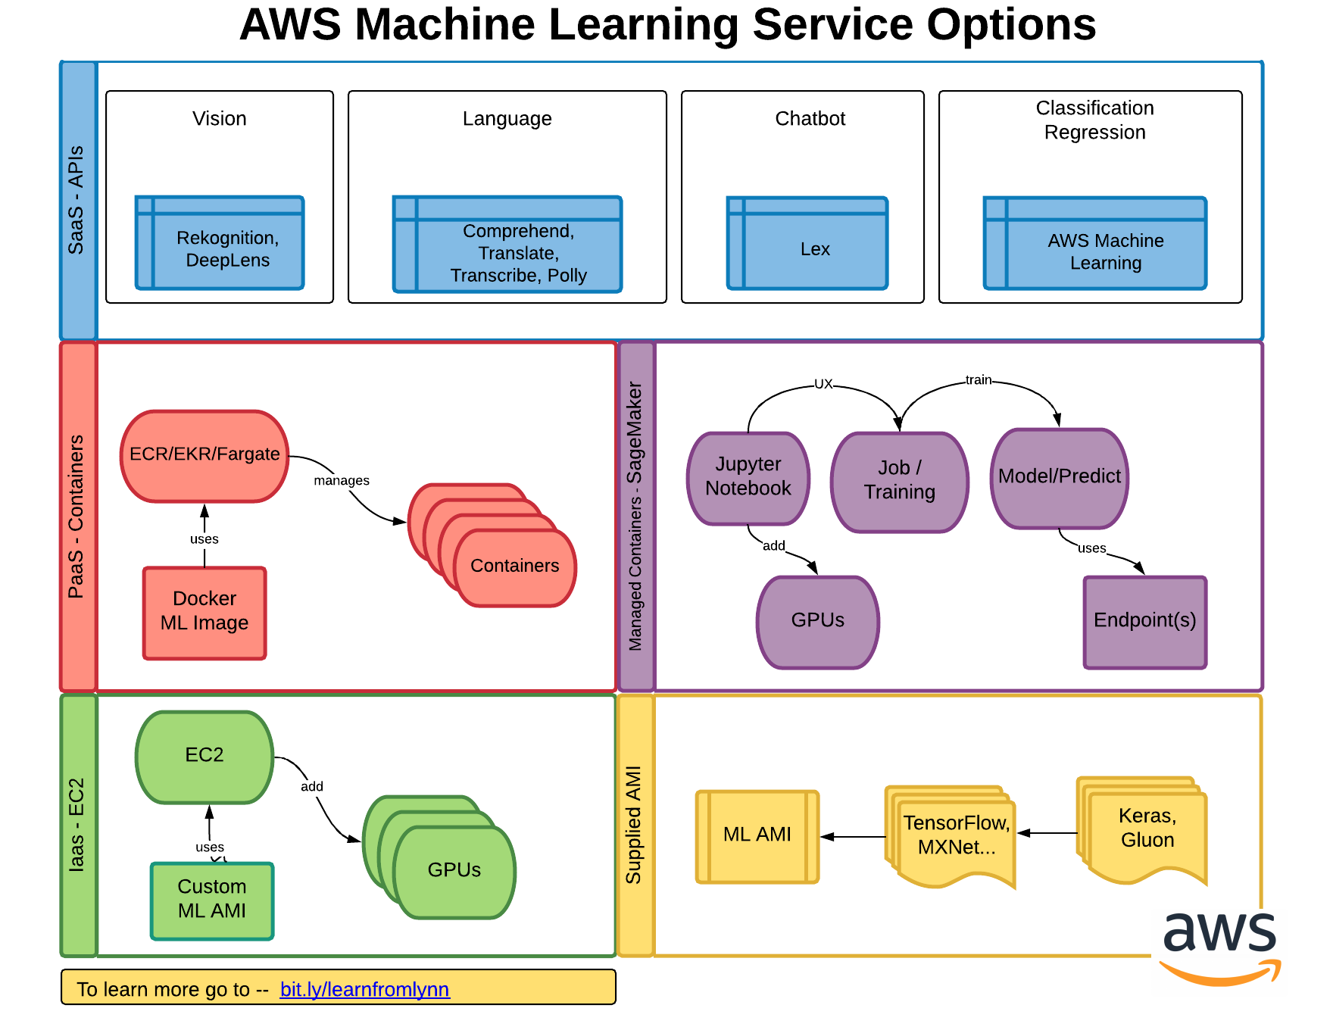

Slide 10
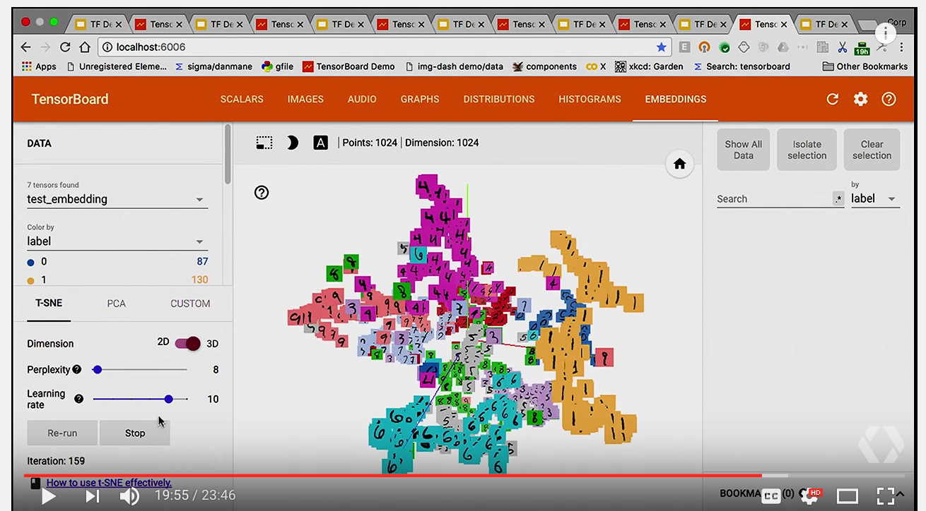

Slide 11
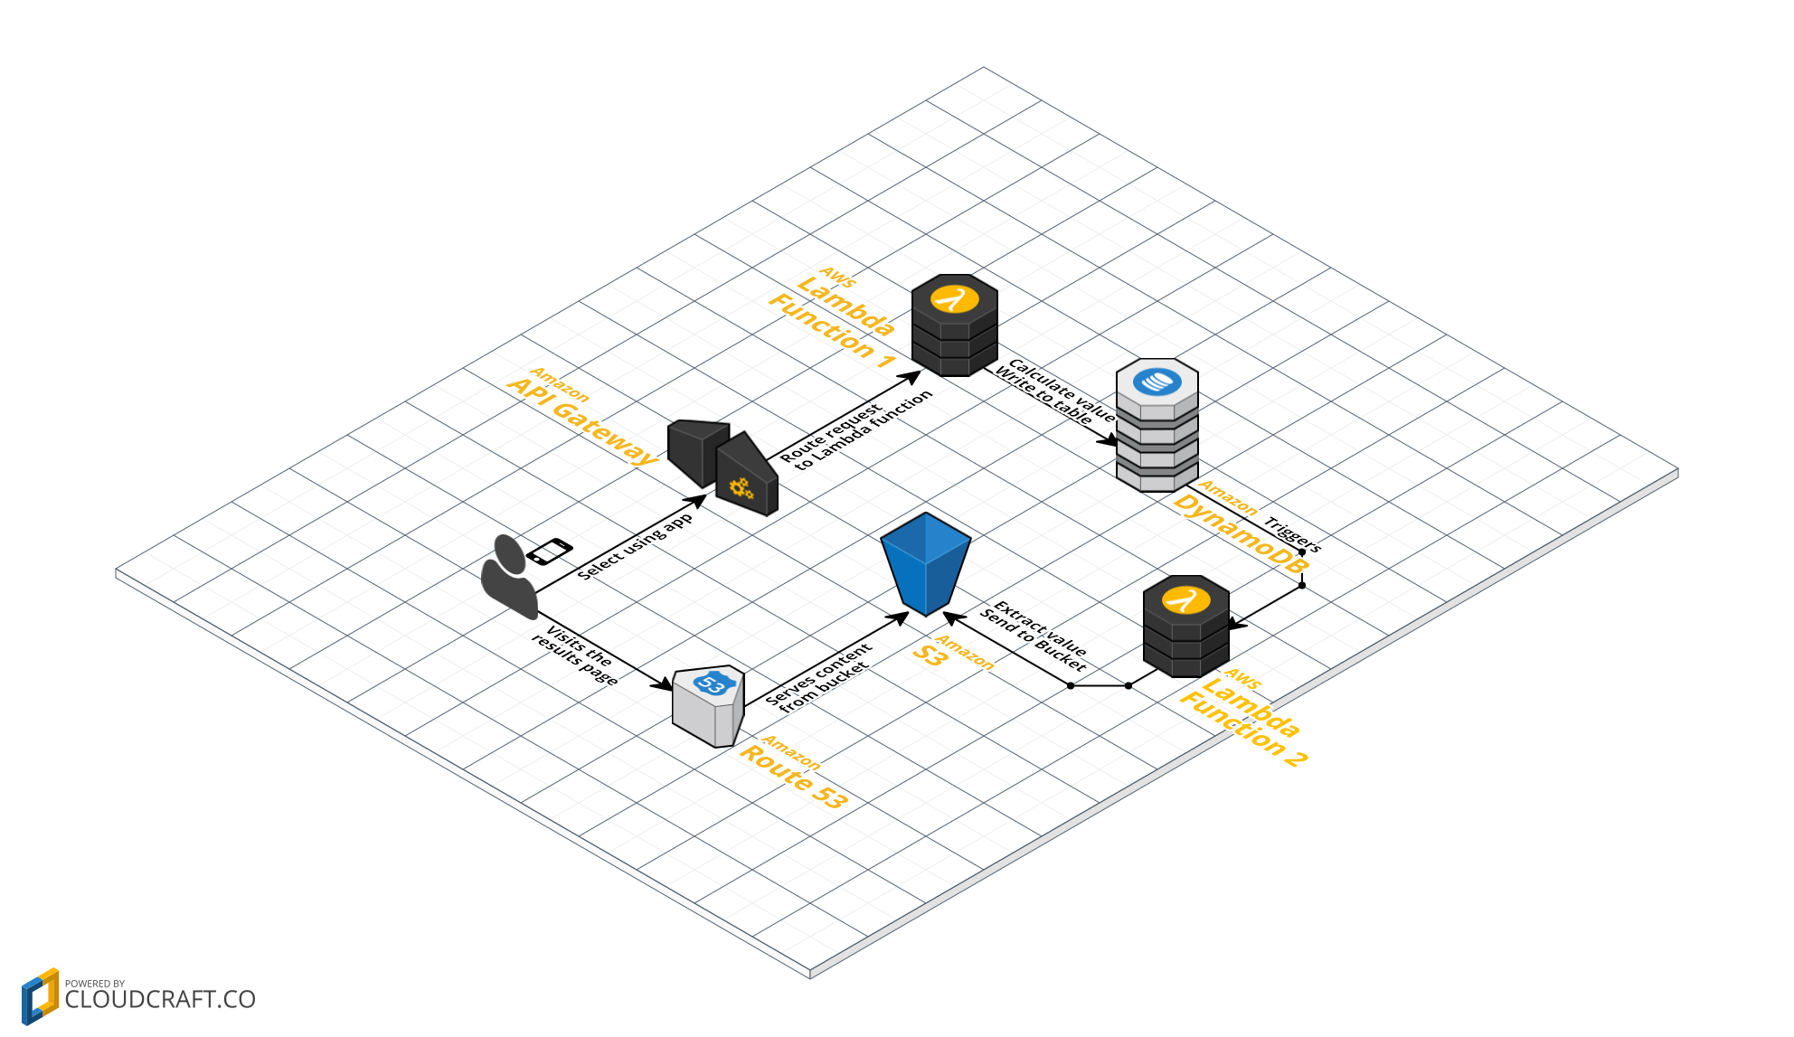

Slide 12
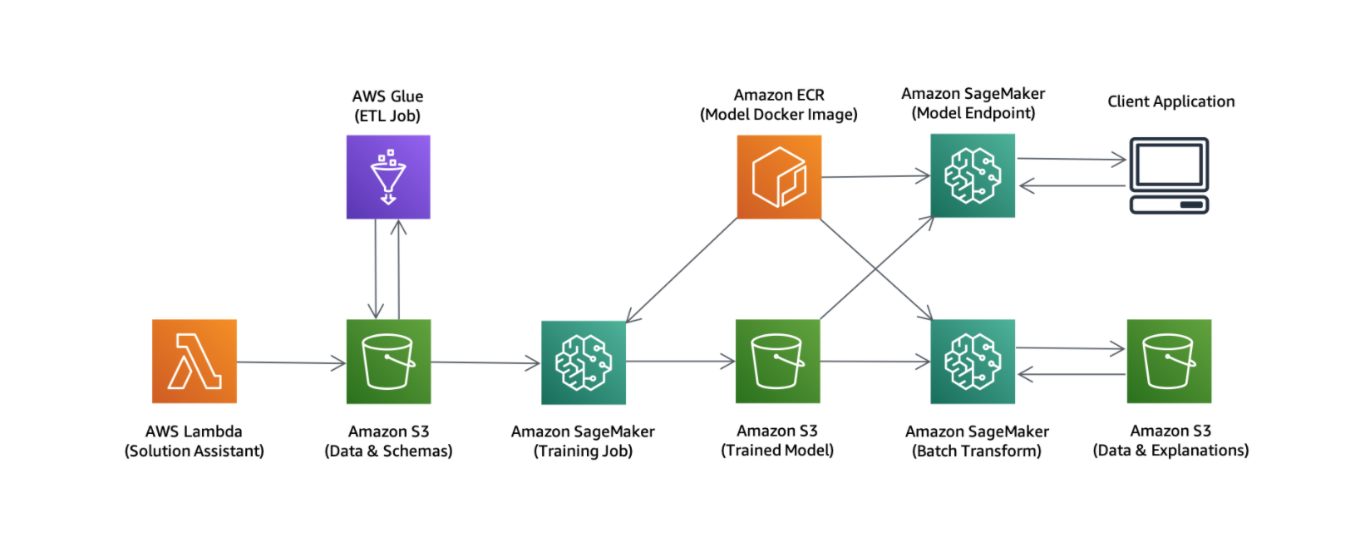

Slide 13
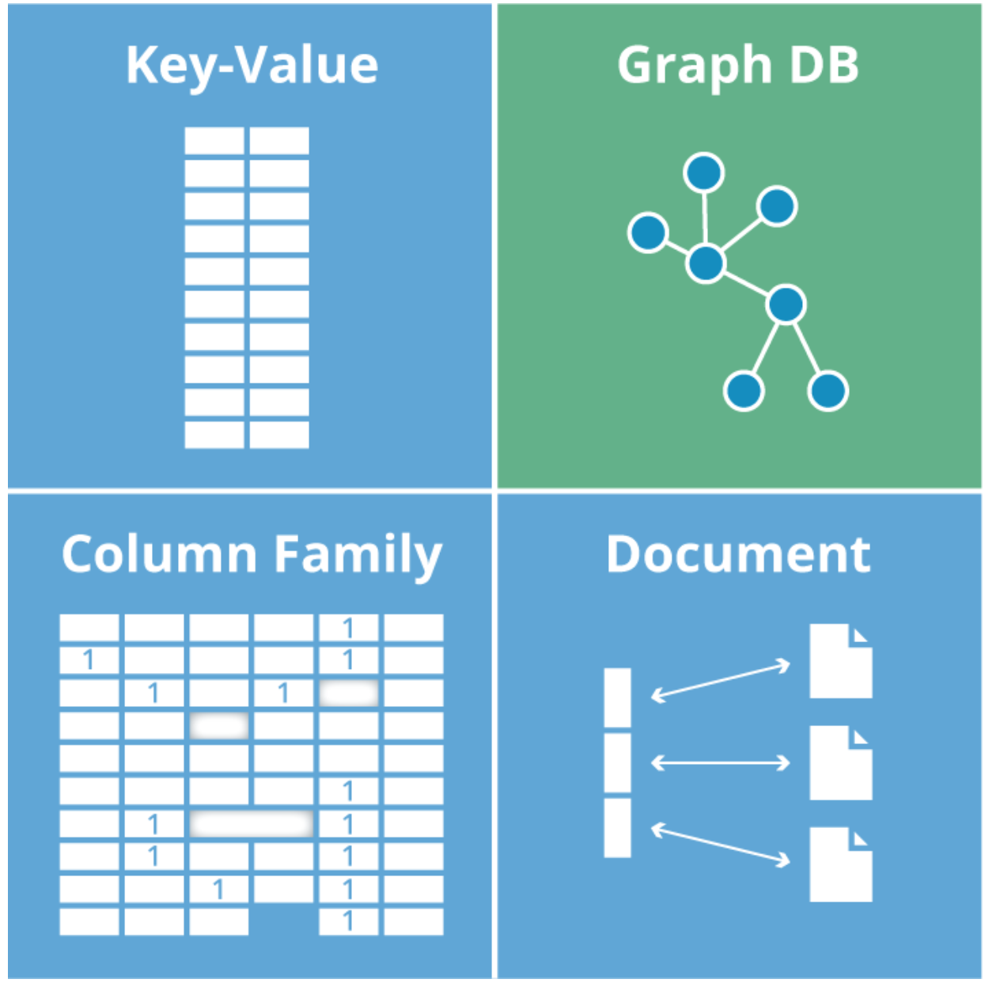
Types of NoSQL Databases
Blended NoSQL
Events
Time streams
Real time
IoT
Ledger
SQL-query layer

Slide 14
Cloud NoSQL Databases
Type | Open Source | AWS | AWS Managed Open Source
Key-Value | Redis | DynamoDB* | ElastiCache for Redis
Columnar | Cassandra | Redshift – Redshift Spectrum | Managed Cassandra
Document | MongoDB | DynamoDB* | DocumentDB for MongoDB
Graph | Neo4j | AWS Neptune | Marketplace Neo4j
Events/IoT | -- | TimeStream, IoT Events* | IoT Core*
Ledger | Hyperledger | QLDB* | --
*Serverless

Slide 15
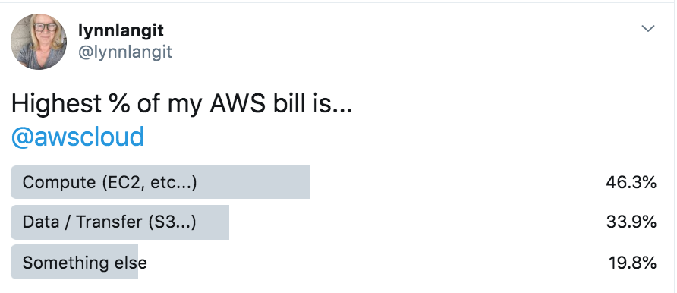

Slide 16
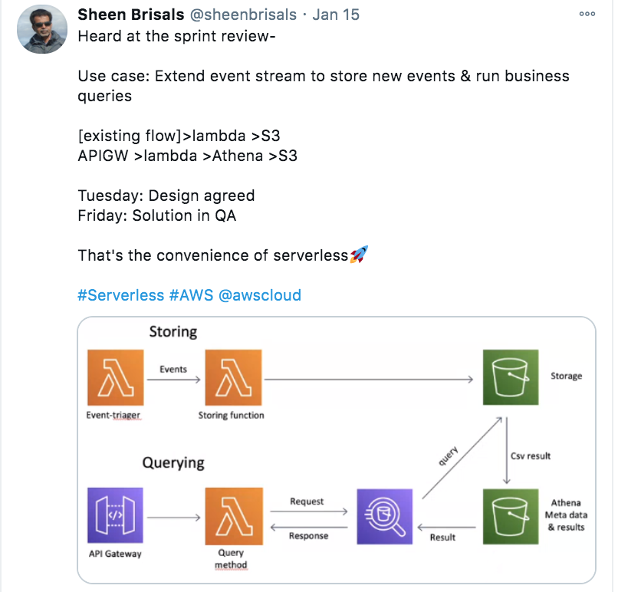

Slide 17
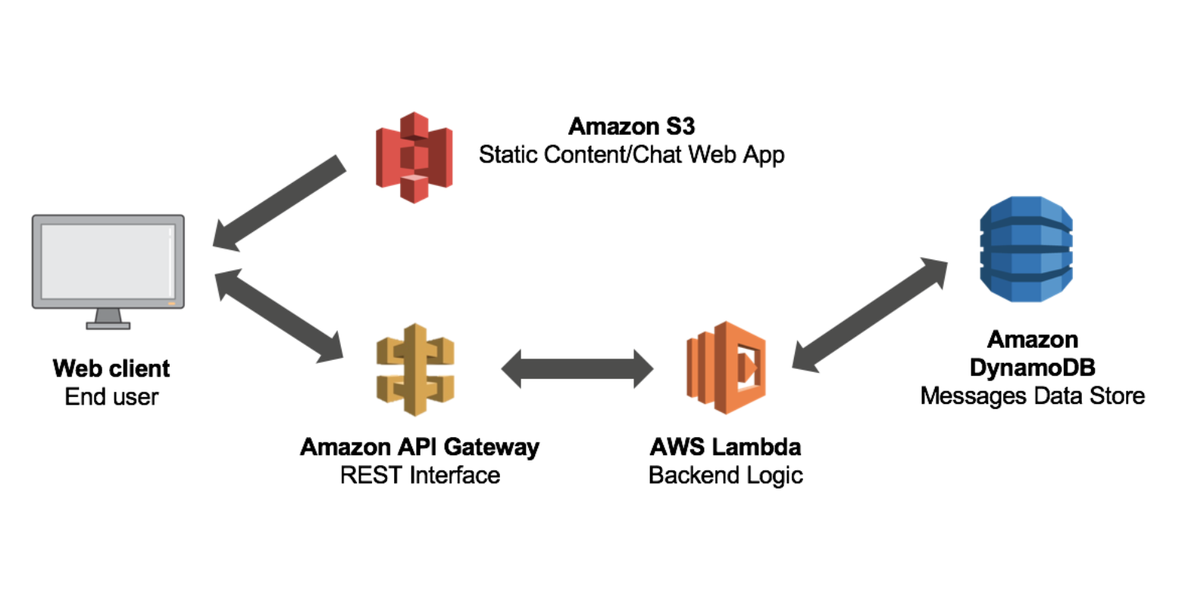

Slide 18
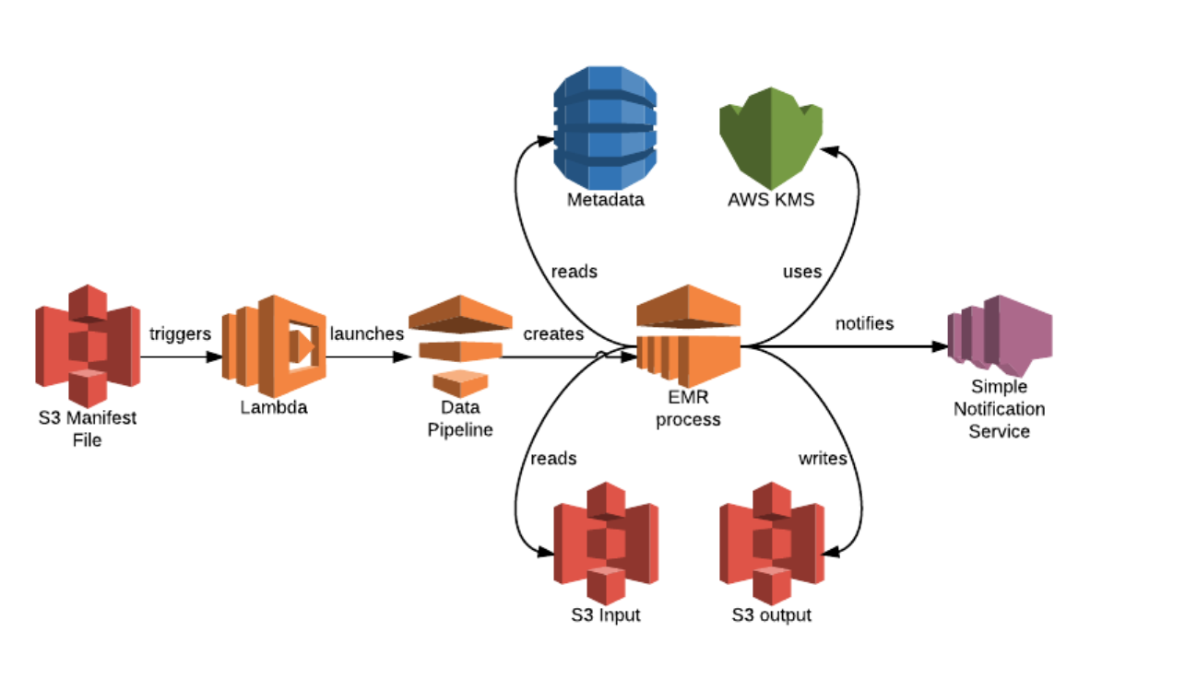

Slide 19
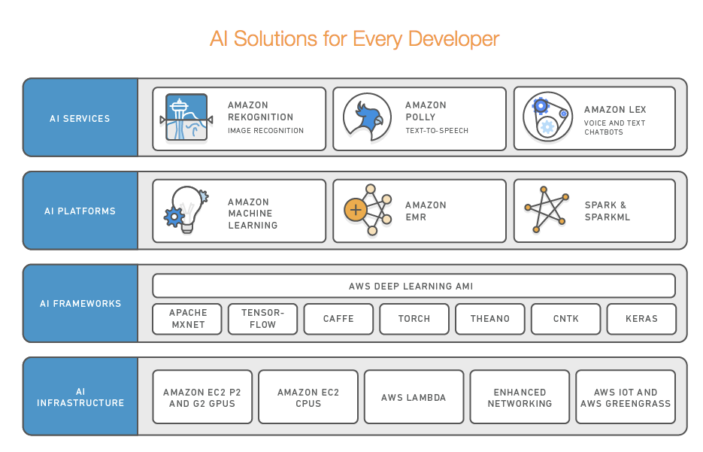

Slide 20
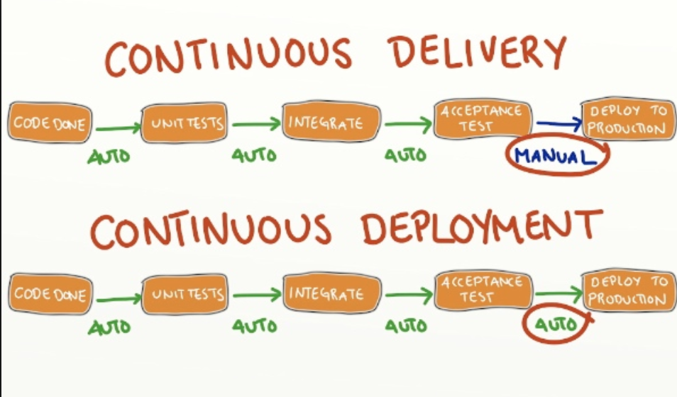
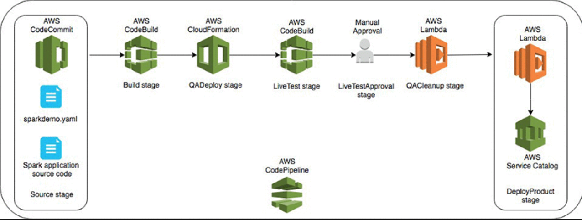

Slide 21
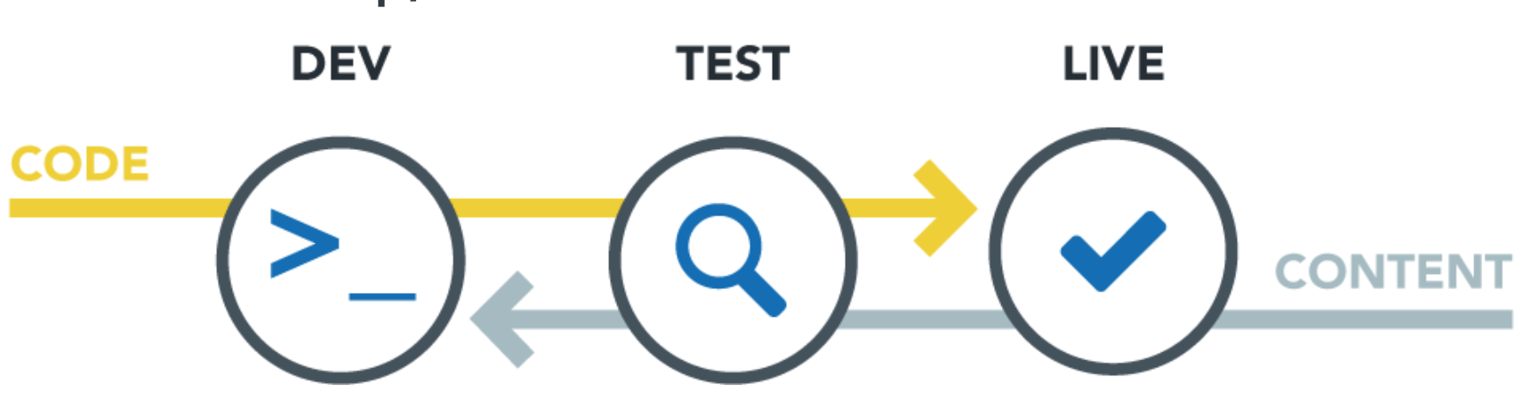
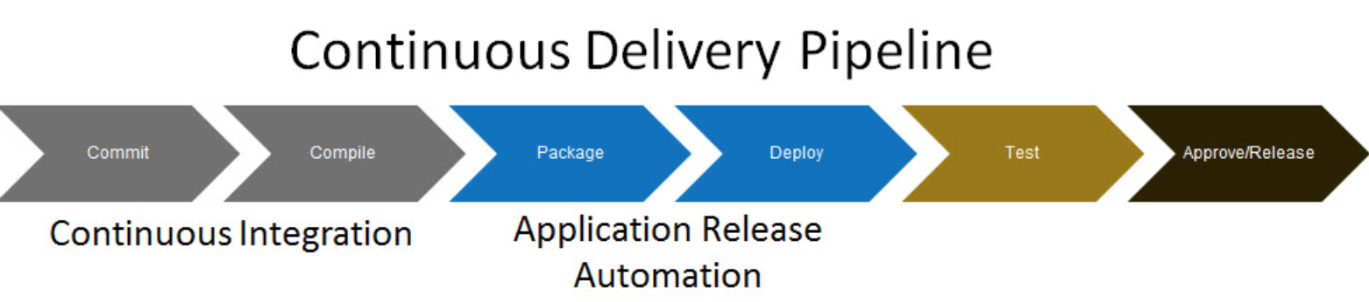

Slide 22
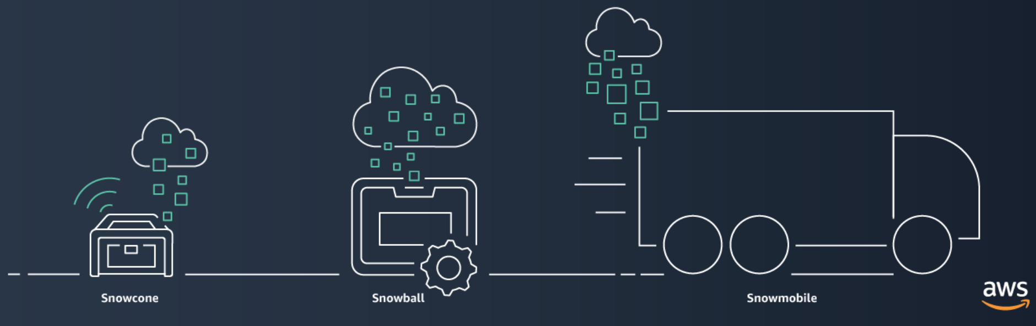
AWS Snow Family - https://aws.amazon.com/snow/
Pick your device (size) – all are RUGGED
Order a device and configure a transfer job via the AWS Console (Snow Series or OpsHub (local))
Receive the device, plug it in, start the job, wait, unplug and send the device back

Slide 23
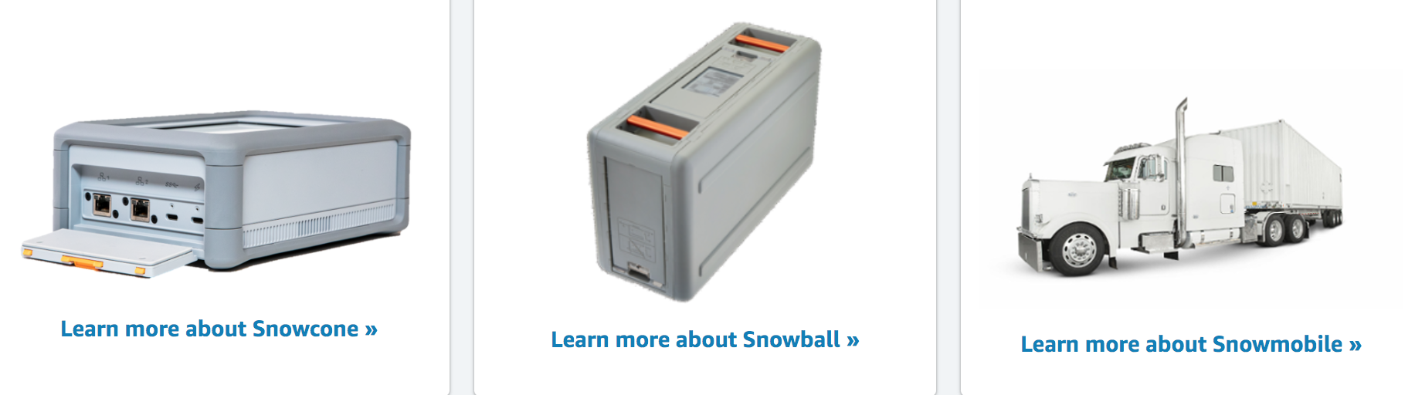
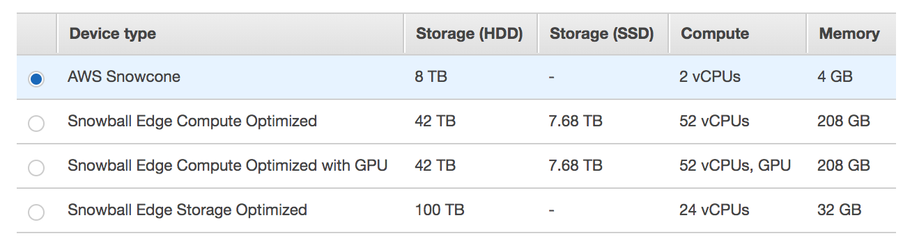
Snowcone – ~ 4 lbs., ~ 8 TB, in your backpack → Edge / IoT / Healthcare / Military
Snowball - ~ 50 lbs. – 42 TB storage, can be racked together → Data Migration, Distributed Storage
Snowmobile ~ 45 ft.-long container – 100 PB, on a semi truck → Data Center Migration (1,250 Snowballs )

Slide 24
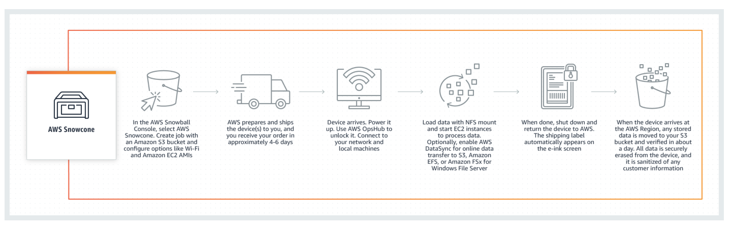
Order it / create job
Wait for shipment
Turn device on, unlock via AWS OpsHub, connect Load data (to S3, EFS or Amazon FSx for WFS)
Shut down and verify label
Verify data on AWS

